Slide 1

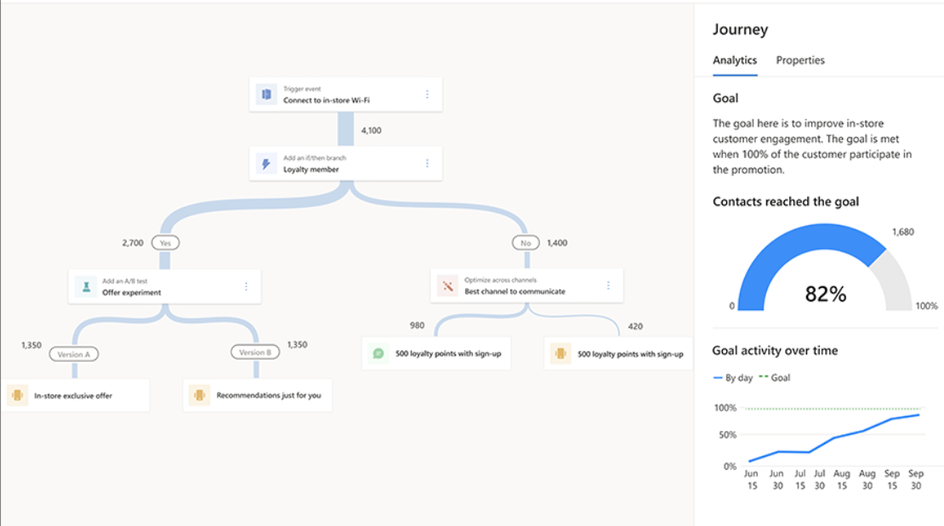
DOXA – Dynamics 365 Marketing Support
Business Need
Doxa’s Marketing team was using Klaviyo for email campaigns, while the Sales team operated within Microsoft Dynamics 365. This separation led to data silos, limited visibility into lead progression, and weak collaboration between Sales and Marketing. The client needed a unified system to align marketing activities with sales outcomes, improve lead quality, and streamline consent and communication management.
What We Did
Affirma integrated and configured Dynamics 365 Customer Insights – Journeys to create a connected marketing and sales ecosystem. Key activities included:
Lead Process Alignment: Defined and implemented MQL/SQL processes to improve lead conversion tracking.
Compliance & Consent Management: Built a compliance profile with defined purposes (Commercial, Events, Marketing, Webinars, Transactional).
Subscription Customization: Customized unsubscribe and topic-subscription forms to support user preferences.
Campaign Enablement: Created reusable templates for Segments, Emails, and Customer Journeys to accelerate campaign execution.
Data & Journey Setup: Supported importing contacts, creating consent records, and building SHRM and Vertical campaign assets within Customer Insights.

